Slide 1

TweetFlow
Aseel Addawood
Chi-Hsien Yen
Linya Huang
Sharanya Bathey

Slide 2
Idea
Show how information spreads through Twitter

Slide 3
Motivation
1. How information spreads around the world through Twitter?
2. What kind of news catch peoples attention?

Slide 4
Audience
Anyone who wants to see how information spreads geographically through Twitter
Additionally, if someone wants to see the top 10 trending topics on Twitter

Slide 5
Questions To Be Answered
1. How quickly information spreads around the world?
2. How widely does the information spread?
3. What are the topics that people retweet? and Why?

Slide 6
Tools
Google Map API or D3 Datamaps
Twitter API
Python or Javascript for Data Processing

Slide 7
Visualization Flow
A world map will show the top 10 most retweeted tweet
When you hover over the tweet icon you can see the tweet text
When you click on one of the tweets you can see how this tweet has spread around the world

Slide 8
Data
Collect twitter data from the past two weeks
Visualize the top 10 retweeted tweets

Slide 9
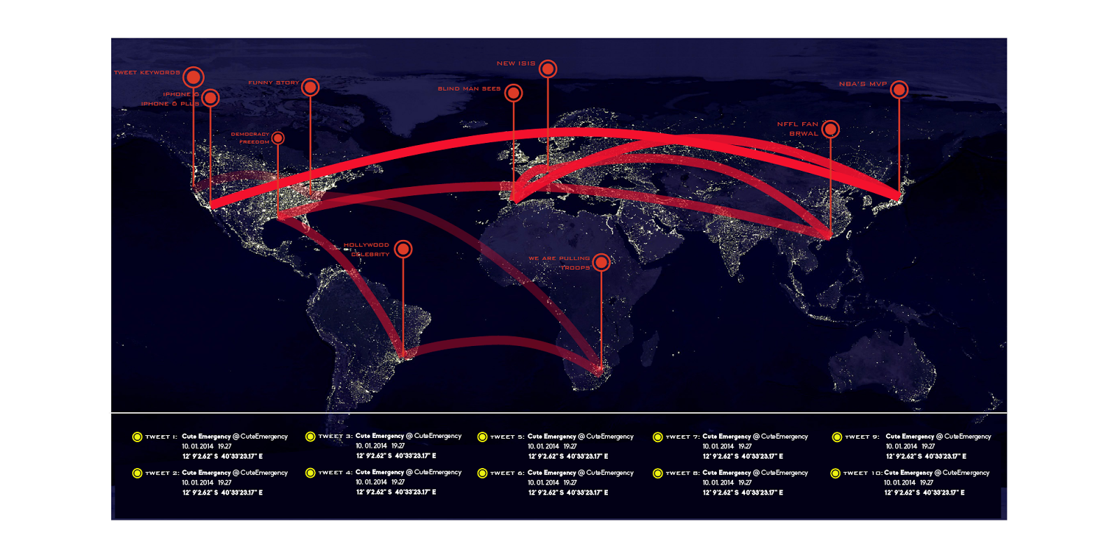
Visualization description

Slide 10
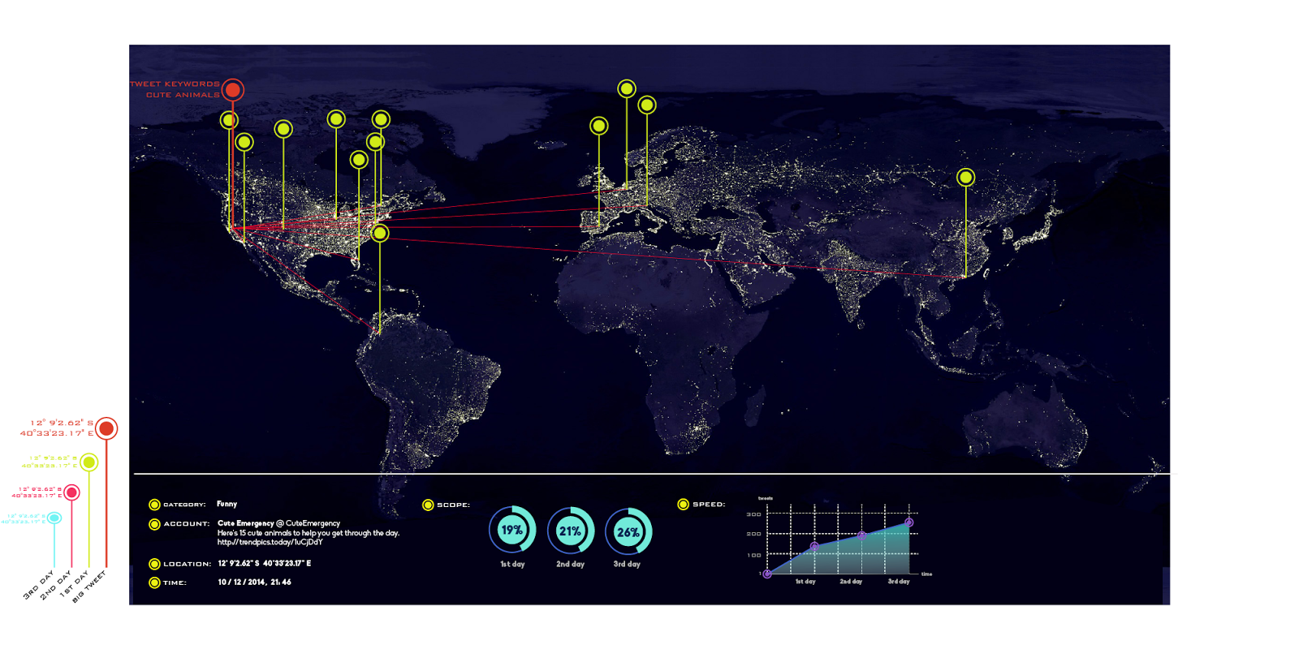
Visualization description

Slide 11
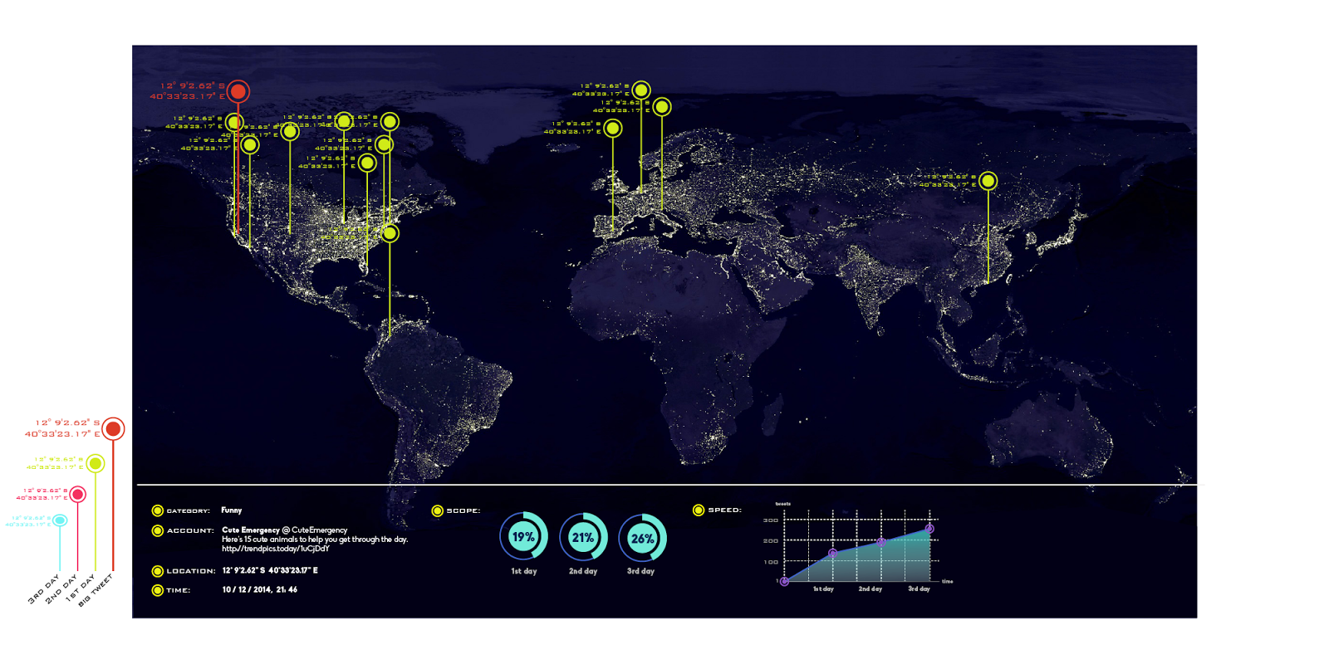
Visualization description

Slide 12
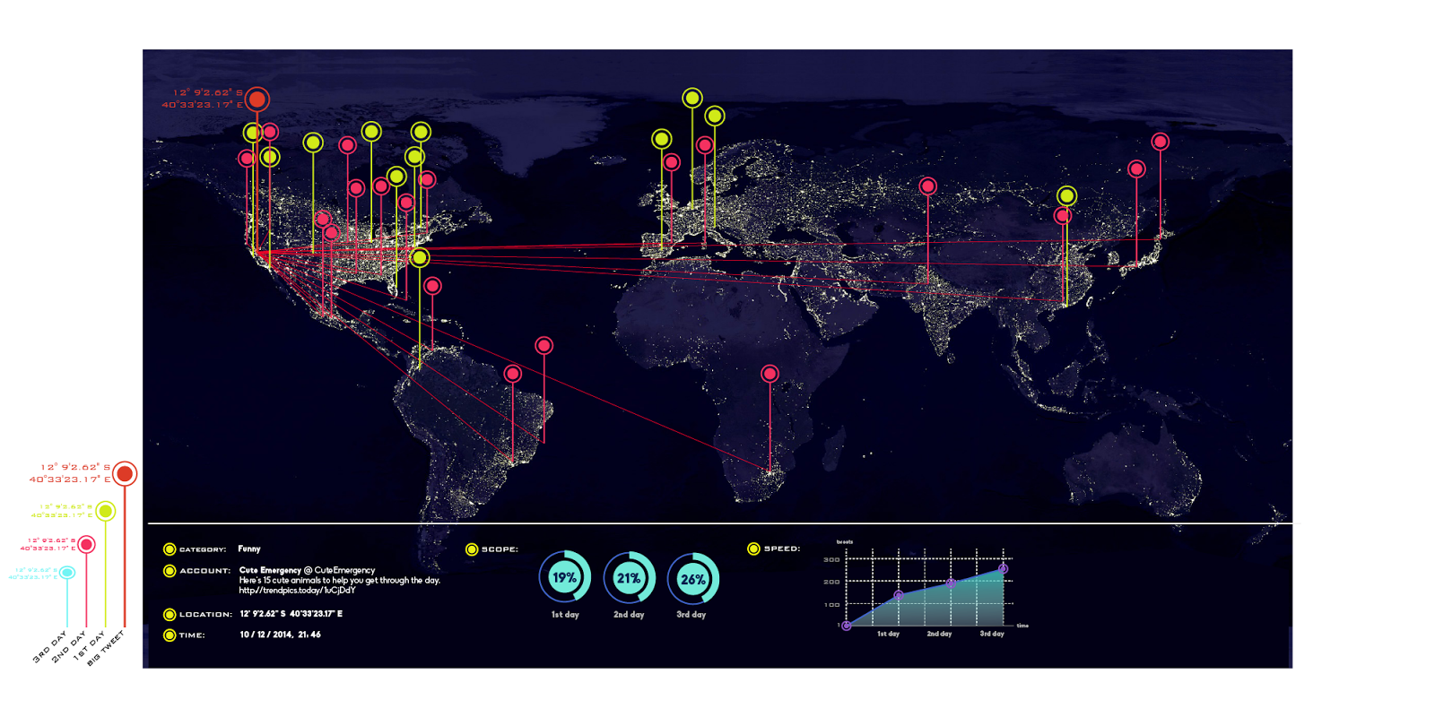
Visualization description
2nd day retweet

Slide 13
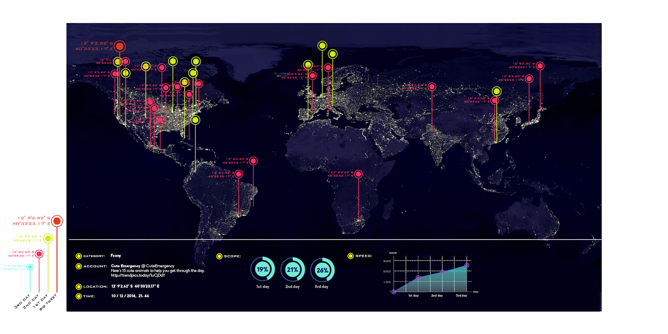
Visualization description

Slide 14
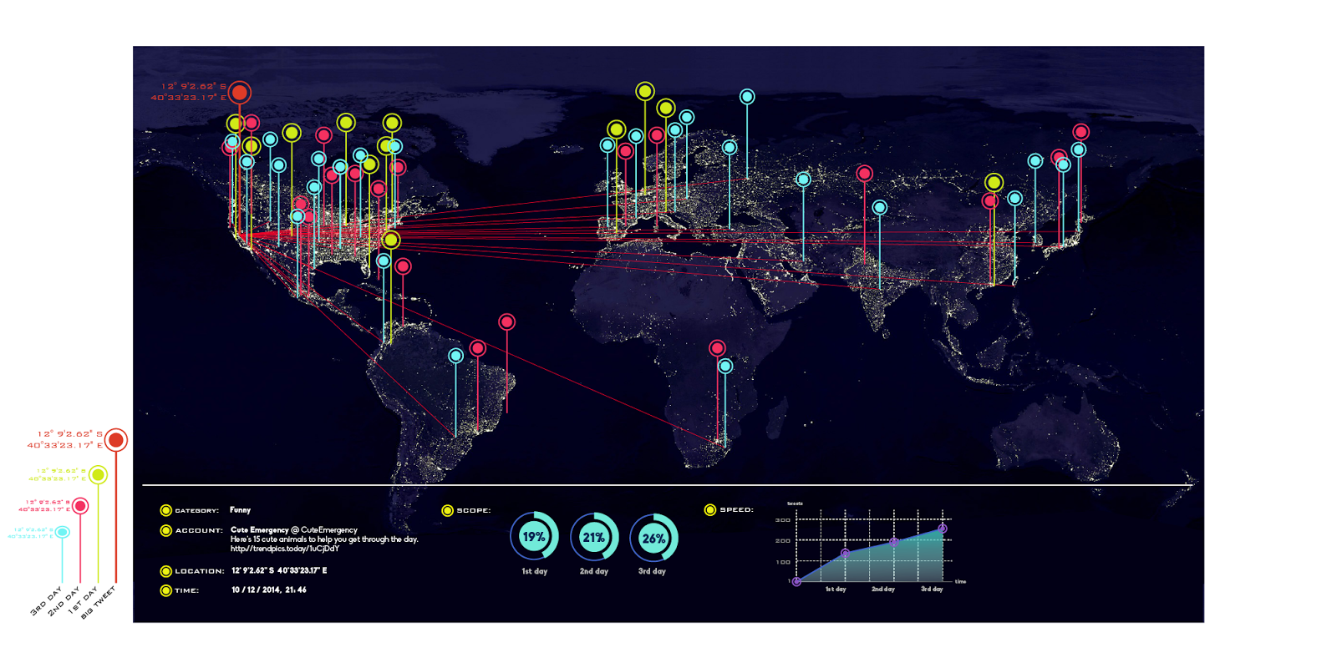
Visualization description

Slide 15
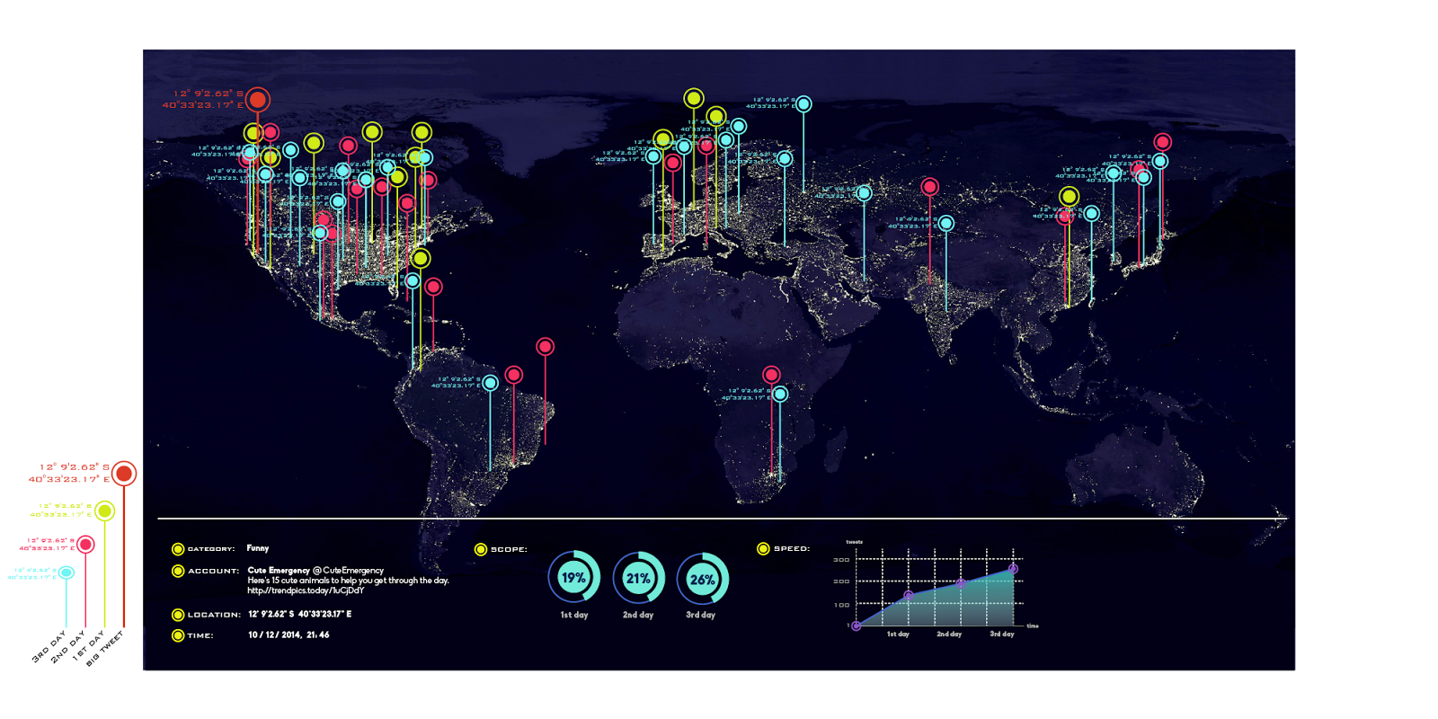
Visualization description

Slide 16
Class Material Incorporated

Slide 17
Questions?

